Slide 1
Cornerstone City Church Peninsula Plus Community Hoo Are Ya 05-02-2023

Slide 2
I reach Up High
CCLI Song # 1075387
Judy Bailey
© 1993 Song Solutions Daybreak (Admin. by Song Solutions www.songsolutions.org)
For use solely with the SongSelect® Terms of Use. All rights reserved. www.ccli.com
CCLI Licence No. 33265

Slide 3
1/3
I reach up high I touch the ground
I stomp my feet and turn around
I've got to (woo woo) Praise the Lord
I jump and dance with all my might
I might look funny but that's alright
I've got to (woo woo)
Praise my Lord

Slide 4
2/3
I'll do anything just for my God
'Cause He's done ev'rything for me
It doesn't matter who is looking on
Jesus is the person that I want to please

Slide 5
3/3
May my whole life be a song of praise
To worship God in ev'ry way
In this song the actions praise His name
I want my actions ev'ry day to do the same

Slide 6
Turn It Up
CCLI Song # 6621485
Andy Harrison
© 2012 Planetshakers Ministries Int. Inc. (Admin. by Song Solutions www.songsolutions.org)
For use solely with the SongSelect® Terms of Use. All rights reserved. www.ccli.com
CCLI Licence No. 33265

Slide 7
1/6
You are here as we lift You up
You are riding on our praise
Be enthroned over everything
You are seated in our praise

Slide 8
2/6
This is prophetic I can feel it in the air
We lift our praise and You change the atmosphere
With hearts open now everybody singing out
(Oh)
(I am free)

Slide 9
3/6
Turn it up this sound of praise
Make it louder than any other
Lift Him up and shout His name over all

Slide 10
4/6
As we praise I can feel the change
As Your presence now invades
Hear the sound of the broken chains
Prison doors are giving way

Slide 11
5/6
Our praise goes up
Your rain comes down
(REPEAT)

Slide 12
6/6
With shouts of praise we celebrate
King of glory enter in
You are riding on our praise oh Lord

Slide 13
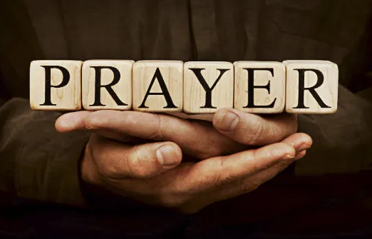

Slide 14
Open The Eyes of My Heart
CCLI Song # 2298355
Paul Baloche
© 1997 Integrity's Hosanna! Music (Admin. by Integrity Music Ltd)
For use solely with the SongSelect® Terms of Use. All rights reserved. www.ccli.com
CCLI Licence No. 33265

Slide 15
1/3
Open the eyes of my heart Lord
Open the eyes of my heart
I want to see You
I want to see You

Slide 16
2/3
To see You high and lifted up
Shining in the light of Your glory
Pour out Your power and love
As we sing holy holy holy

Slide 17
3/3
Holy holy holy
Holy holy holy
Holy holy holy
I want to see You

Slide 18
Show Your Power
CCLI Song # 861891
Kevin Prosch
© 1991 Mercy / Vineyard Publishing (Admin. by Integrity Music Ltd)
For use solely with the SongSelect® Terms of Use. All rights reserved. www.ccli.com
CCLI Licence No. 33265

Slide 19
1/4
Well He is the Lord He reigns on high
He is the Lord
Spoke into the darkness created the light
He is the Lord
Who is like unto Him never ending in days
He is the Lord
And He comes in power when we call on His name
He is the Lord

Slide 20
2/4
Show Your power oh Lord our God
Show Your power oh Lord our God
Oh Lord our God

Slide 21
Your gospel oh Lord is the hope for our nation
You are the Lord
It's the power of God for our salvation
You are the Lord
We ask not for riches but look to the cross
You are the Lord
And for our inheritance give us the lost
You are the Lord
3/4

Slide 22
4/4
Show Your power oh Lord our God
Show Your power oh Lord our God
Oh Lord our God

Slide 24
Way Maker CCLI Song # 7115744
Osinachi Kalu Okoro Egbu
© 2016 Integrity Music Europe (Admin. by Integrity Music)
For use solely with the SongSelect® Terms of Use. All rights reserved. www.ccli.com
CCLI Licence No. 33265

Slide 25
1/4
You are here moving in our midst I worship You I worship You You are here working in this place I worship You I worship You
(You are) Way Maker Miracle Worker Promise Keeper Light in the darkness my God that is who You are

Slide 26
2/4
You are here touching ev'ry heart I worship You I worship You You are here healing ev'ry heart I worship You I worship You
(You are) Way Maker Miracle Worker Promise Keeper Light in the darkness my God that is who You are

Slide 27
You are here turning lives around I worship You I worship You You are here mending ev'ry heart I worship You yeah I worship You Lord
(You are) Way Maker Miracle Worker Promise Keeper Light in the darkness my God that is who You are
3/4

Slide 28
That is who You are x4
Even when I don't see it You're working Even when I don't feel it You're working You never stop You never stop working x2
4/4

Slide 29
Goodness Of God
CCLI Song # 7117726
Ben Fielding | Brian Johnson | Ed Cash | Jason Ingram | Jenn Johnson
© 2018 Capitol CMG Paragon (Admin. by Capitol CMG Publishing)
Fellow Ships Music (Admin. by Essential Music Publishing LLC)
So Essential Tunes (Admin. by Essential Music Publishing LLC)
SHOUT! Music Publishing Australia (Admin. by SHOUT! Music Publishing UK)
Bethel Music Publishing (Admin. by Song Solutions)
For use solely with the SongSelect® Terms of Use. All rights reserved. www.ccli.com
CCLI Licence No. 33265

Slide 30
1/4
I love You Lord
Oh Your mercy never fails me
All my days
I've been held in Your hands
From the moment that I wake up
Until I lay my head
I will sing of the goodness of God

Slide 31
2/4
All my life You have been faithful
All my life You have been so so good
With every breath that I am able
I will sing of the goodness of God

Slide 32
3/4
I love Your voice
You have led me through the fire
In darkest night
You are close like no other
I've known You as a father
I've known You as a friend
I have lived in the goodness of God

Slide 33
4/4
Your goodness is running after
It’s running after me
Your goodness is running after
It’s running after me
With my life laid down
I’m surrendered now
I give You everything
Your goodness is running after
It's running after me

Slide 34
Worthy Of it All
CCLI Song # 6280644
David Brymer | Ryan Hall
© 2012 Common Hymnal Publishing (Admin. by Integrity Music Ltd)
Innerland (Admin. by Integrity Music Ltd)
Underground Treasure (Admin. by Integrity Music Ltd)
Wayfinder Music (Admin. by Integrity Music Ltd)
For use solely with the SongSelect® Terms of Use. All rights reserved. www.ccli.com
CCLI Licence No. 33265

Slide 35
1/3
All the saints and angels
Bow before Your throne
All the elders cast their crowns
Before the Lamb of God and sing

Slide 36
2/3
You are worthy of it all
You are worthy of it all
For from You are all things
And to You are all things
You deserve the glory

Slide 37
3/3
Day and night,
Night and day,
Let incense arise
(X4)
Day and night
Night and day

Slide 40


Slide 41
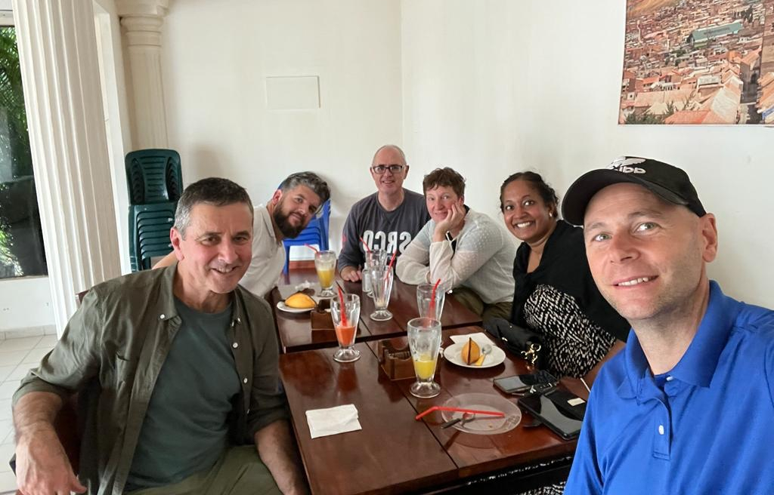
The Bolivia team has arrived safely and here they are enjoying breakfast!

Slide 42


Slide 43
Don't forget next Weds we have the RM Live broadcast 8pm-9pm (CCC will be leading the way on tech and background stuff as usual). If your Communities/Groups are able to tune in or meet together and watch and then pray then that is encouraged and cheered on!

Slide 44


Slide 45
Want to grow in the prophetic gift? Hear about what might be saying to his church? A great mix of prophets, teachers and apostles speaking at this RM event. Idayat (Bisi) is coordinating to take a group up there or can meet you up there in Cambridge. Book in or get in touch with Idayat for more info. 07863 226079

Slide 46


Slide 47


Slide 48
🇳 🇪 🇼 🇩 🇦 🇾 2⃣0⃣2⃣3⃣
Parents/Carers of 11-18 yr olds (year groups 6 - year groups 13)...
BOOKINGS ARE NOW OPEN!!
All the relevant info- including links to each of the 3 booking steps are in
the letter linked below:👇🏼👇🏼👇🏼👇🏼👇🏼👇🏼👇🏼👇🏼
Bit.ly/newday2023invitePlease note, the early bird cut off is 31st Jan.
Do get in touch if you have any questions or need to talk about finances!
202 days and counting...⏳⛺🎪⛺🎪⛺🎪⛺🎪⛺🎪Ps.
Here's a brief 60 second Newday promo for anyone who needs it...

Slide 49
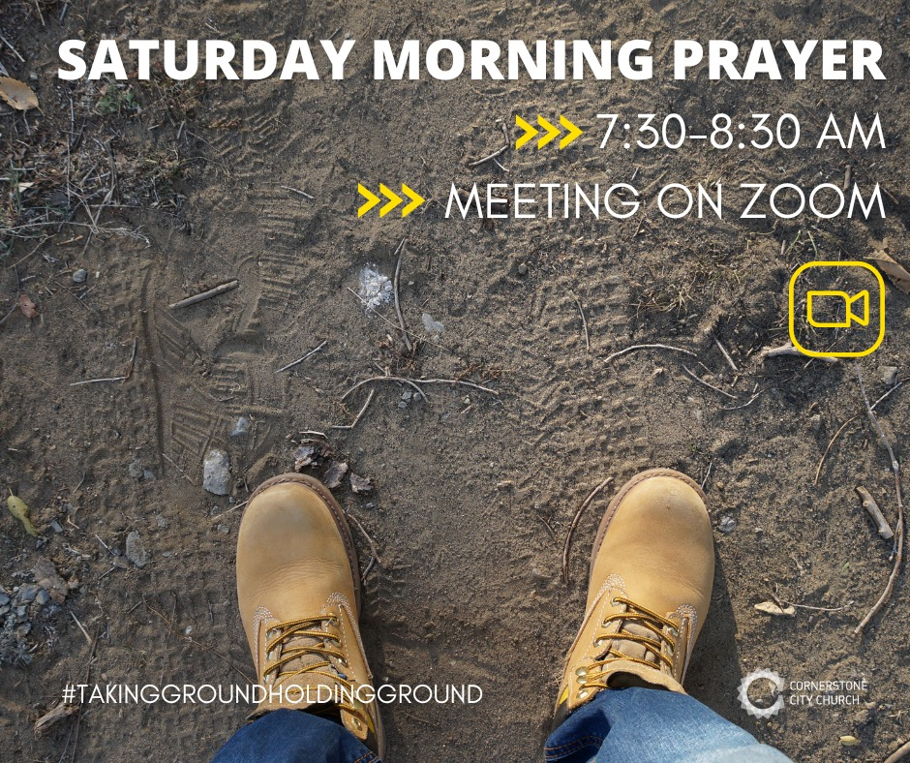

Slide 51
God of This City
CCLI Song # 5037070
Aaron Boyd | Andrew McCann | Ian Jordan | Peter Comfort | Peter Kernoghan | Richard Bleakley
© 2006 Thankyou Music (Admin. by Integrity Music Ltd)
For use solely with the SongSelect® Terms of Use. All rights reserved. www.ccli.com
CCLI Licence No. 33265

Slide 52
1/2
You're the God of this city
You're the King of these people
You're the Lord of this nation
You are
You're the light in this darkness
You're the hope to the hopeless
You're the peace to the restless
You are

Slide 53
2/2
There is no one like our God
There is no one like You God
Greater things have yet to come
And greater things have still to be done
In this city
Greater things have yet to come
And greater things have still to be done here

Slide 54
An Army Of Ordinary People
CCLI Song # 222241
Dave Bilbrough
© 1983 Thankyou Music (Admin. by Integrity Music Ltd)
For use solely with the SongSelect® Terms of Use. All rights reserved. www.ccli.com
CCLI Licence No. 33265

Slide 55
1/3
An army of ordinary people
A kingdom where love is the key
A city a light to the nations
Heirs to the promise are we
A people whose life is in Jesus
A nation together we stand
Only through grace are we worthy
Inheritors of the land

Slide 56
2/3
An army of ordinary people
A kingdom where love is the key
A city a light to the nations
Heirs to the promise are we
A people whose life is in Jesus
A nation together we stand
Only through grace are we worthy
Inheritors of the land

Slide 57
3/3
A people without recognition
But with Him a destiny sealed
Called to a heavenly vision
His purpose shall be fulfilled
Come let us stand strong together
Abandon ourselves to the King
His love shall be ours forever
This vict'ry song we shall sing

